Slide 1
MANAGEMENT INFORMATION SYSTEM
REFERENCES:
Kelly Rainer, Brad Prince, Management Information Systems, Wiley
K.C. Laudon and J.P. Laudon, Management Information Systems: Managing the Digital Firm, 10th Ed., Prentice Hall, 2007.
D. Boddy, A. Boonstra, Managing Information Systems: Strategy and Organization, Prentice Hall, 2008

Slide 2
Module 1
Introduction To Information Systems (IS)
Computer Based Information Systems (Chapter 1)
Impact of IT on organizations (Chapter 1)
Importance of IS to Society (Chapter 1)
Organizational Strategy (Chapter 2)
Competitive Advantages and IS(Chapter 2)
Notes:
2

Slide 3
1
Introduction to Information Systems

Slide 4
Information technology (IT)
IT has far reaching effect on individuals, organizations and our planet.
IT has created a significant impact on individuals, societies, global economy and physical environment.
IT is making world smaller and enabling people to communicate, collaborate and compete
Environment is global, massively interconnected, intensely competitive, 24/7/365, real time , rapidly changing and information intensive….so organization must use IT effectively

Slide 5
Introduction To Information Systems (IS)
Information technology (IT) refers to any computer-based tool that people use to work with information and to support the information and information processing needs of an organization.
Information System(IS) collects, process, stores, analyzes and disseminates information for the specific purposes

Slide 6

Why Should I Study Information Systems ?
The Informed User – You!
IT Offers Career Opportunities
Managing Information Resources
Notes:
Information Technology (IT): any computer-based tool that people use to work with information and to support the information and information-processing needs of an organization.
Information System (IS): collects, processes, stores, analyzes, and disseminates information for a specific purpose.
Informed User: A person knowledgeable about information systems and information technology

Slide 7
Reasons Why You Should Be An Informed User…
You will benefit more from your organization’s IT applications because you will understand what is “behind” those applications.
Your input can enhance your organization’s IT applications.
As you enter the workforce you can assist in selecting the IT applications your organization will use.

Slide 8
Reasons Why You Should Be An Informed User (con’t)…
You will aware of both new information technologies and rapid developments in existing technologies.
You will understand how using IT can improve your organization’s performance.
If you are entrepreneurial minded, you can use IT to start your own business.

Slide 9

Why should I study IS? IT skills open many doors because IT is so widely used.

Slide 10

IT Offers Career Opportunities
Chief Information Officer (CIO)
Substantial Demand for IT Staff
Programmers
Business Analysts
System Analysts
Designers
Notes:
CIO: The executive who is in charge of the IS function

Slide 11
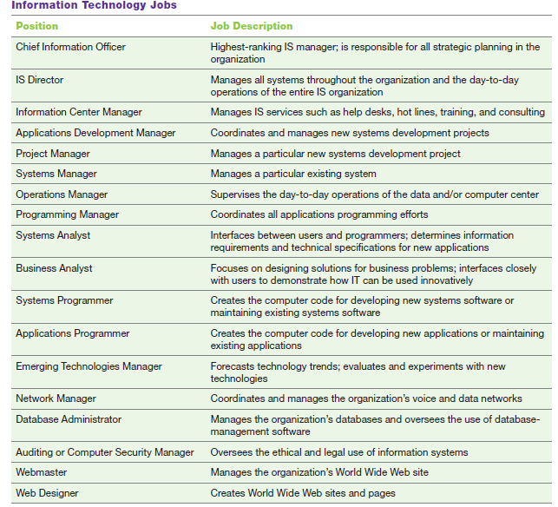
IT Offers Career Opportunities

Slide 12
Managing Information Resources
Managing information systems (IS) is difficult and complex
Contributing Factors:
Strategic value of IS’s
Acquiring, operating, and maintaining IS’s is very expensive
Evolution of the IS Function
Notes:
Evolution of the IS Function….
Traditional Functions of the MIS Department:
• Managing systems development and systems project management
• Managing computer operations, including the computer center
• Staffing, training, and developing IS skills
• Providing technical services
• Infrastructure planning, development, and control
New (Consultative) Functions of the MIS Department
• Initiating and designing specific strategic information systems
• Incorporating the Internet and electronic commerce into the business
• Managing system integration including the Internet, intranets, and extranets
• Educating the non-MIS managers about IT
• Educating the MIS staff about the business
• Partnering with business-unit executives
• Managing outsourcing
• Proactively using business and technical knowledge to seed innovative ideas about IT
• Creating business alliances with business partners

Slide 13
Managing Information Resources
Strategic value of IS’s
First, information systems have enormous strategic value to organizations. Firms rely on them so heavily that, in some cases, when these systems are not working (even for a short time), the firm cannot function. (This situation is called “being
hostage to information systems.”)

Slide 14
Managing Information Resources
Second, Acquiring, operating, and maintaining IS’s is very expensive
Third factor contributing to the difficulty in managing information systems is the evolution of the management information systems (MIS) function within the organization.
When businesses first began to use computers in the early 1950s, the MIS department “owned” the only computing resource in the organization, the mainframe. At that time, end users did not interact directly with the mainframe.
In modern organization MIS department now act as a consultants to end users, viewing them as customers
MIS department is to use IT to solve end-user problems

Slide 15
Evolution of the IS Function….
Traditional Functions of the MIS Department:
• Managing systems development and systems project management
• Managing computer operations, including the computer center
• Staffing, training, and developing IS skills
• Providing technical services
• Infrastructure planning, development, and control

Slide 16
Evolution of the IS Function….
New (Consultative) Functions of the MIS Department.
• Initiating and designing specific strategic information systems
• Incorporating the Internet and electronic commerce into the business
• Managing system integration including the Internet, intranets, and extranets
• Educating the non-MIS managers about IT
• Educating the MIS staff about the business
• Partnering with business-unit executives
• Managing outsourcing
• Proactively using business and technical knowledge to seed innovative ideas about IT
• Creating business alliances with business partners

Slide 17
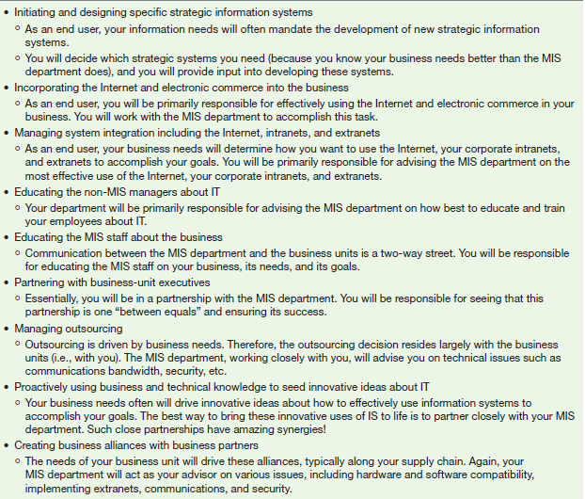
New (Consultative) Functions of the MIS Department

Slide 18
Overview of Computer-Based IS’s
Data – Information – Knowledge
Computer-Based Information System (CBIS)
Types of Computer-Based Information Systems (CBIS)
Notes:
Computer-Based Information Systems (CBIS): an information system that uses computer technology to perform some or all of the its intended tasks.

Slide 19
Overview of Computer-Based Information Systems
Information systems has been defined as getting the right information to the right people, at the right time, in the right amount, and in the right format.

Slide 20
Data
Data items refer to an elementary description of things, events, activities, and transactions
that are recorded, classified, and stored but are not organized to convey any specific meaning.
Data items can be numbers, letters, figures, sounds, and images.
Examples of data items are collections of numbers (e.g., 3.11, 2.96, 3.95, 1.99, 2.08) and characters (e.g., B, A, C, A, B, D, F, C).

Slide 21
Information
Information refers to data that have been organized so that they have meaning and value to the recipient.
For example, a grade point average (GPA) by itself is data, but a student’s name coupled with his or her GPA is information.
The recipient interprets the meaning and draws conclusions and implications from the information..

Slide 22
Knowledge
Knowledge consists of data and/or information that have been organized and processed to convey understanding, experience, accumulated learning, and expertise as they apply to a current business problem.
For example, suppose that a company recruiting at your school has found over time that students with grade point averages over 3.0 have experienced the greatest success in its management program.
Based on this accumulated knowledge, that company may decide to interview only those students with GPAs over 3.0.
This example presents an example of knowledge because the company utilizes information—GPAs—to address a business problem—hiring successful employees. As

Slide 23
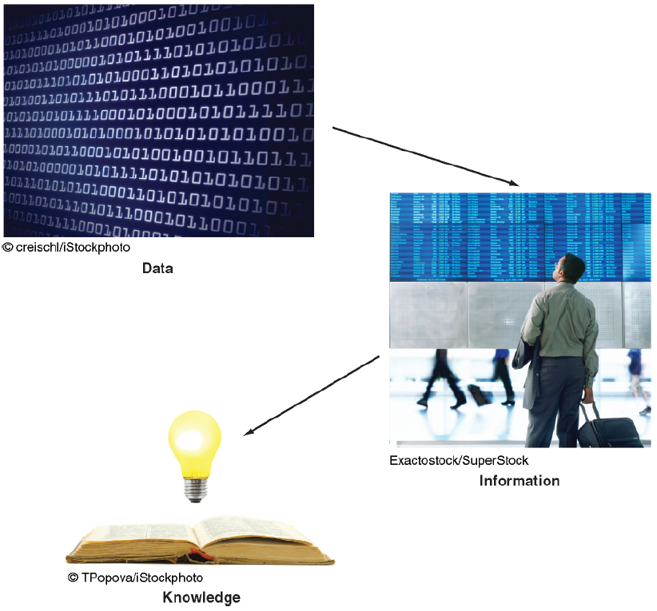
Data – Information – Knowledge

Slide 24
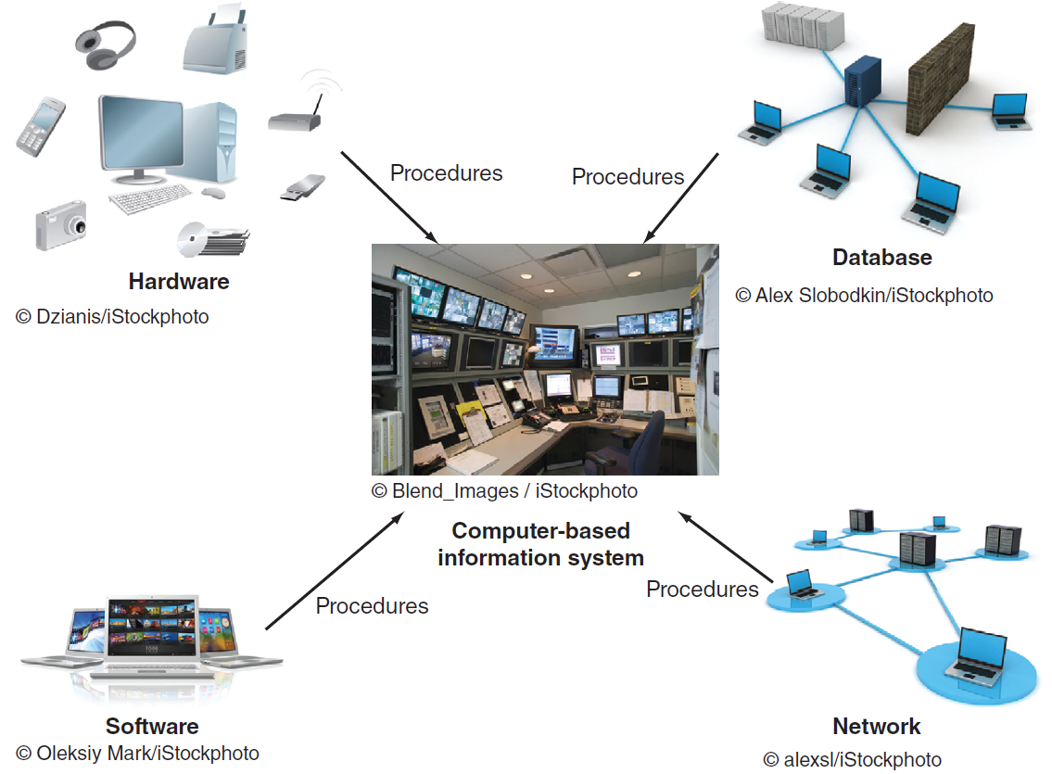
A computer-based information system (CBIS)
Notes:
Data Items: an elementary description of things, events, activities, and transactions that are recorded, classified, and stored but are not organized to convey any specific meaning.
Information: refers to data that have been organized so that they have meaning and value to the recipient.
Knowledge: consists of data and/or information that have been organized and processed to convey understanding, experience, accumulated learning, and expertise as they apply to a current business problem.

Slide 25
Components of a CBIS
Hardware
Software
Database
Network
Procedures
People
Notes:
Hardware: consists of devices such as the processor, monitor, keyboard, and printer.
Software: a program or collection of programs that enable the hardware to process data.
Database: a collection of related fi les or tables containing data.
Network: a connecting system (wireline or wireless) that permits different computers to share resources.
Procedures: are the instructions for combining the above components to process information and generate the desired output.
People: individuals who use the hardware and software, interface with it, or utilize its output.

Slide 26
A computer-based information system(CBIS)
A computer-based information system (CBIS) is an information system that uses computer technology to perform some or all of its intended tasks.
Four components interact to form a CBIS.
Hardware consists of devices such as the processor, monitor, keyboard, and printer.
Together, these devices accept, process, and display data and information.
Software is a program or collection of programs that enable the hardware to process data.
A database is a collection of related files or tables containing data.
A network is a connecting system (wireline or wireless) that permits different computers to share resources.
Procedures are the instructions for combining the above components to process information and generate the desired output.
People are those individuals who use the hardware and software, interface with it, or utilize its output.

Slide 27
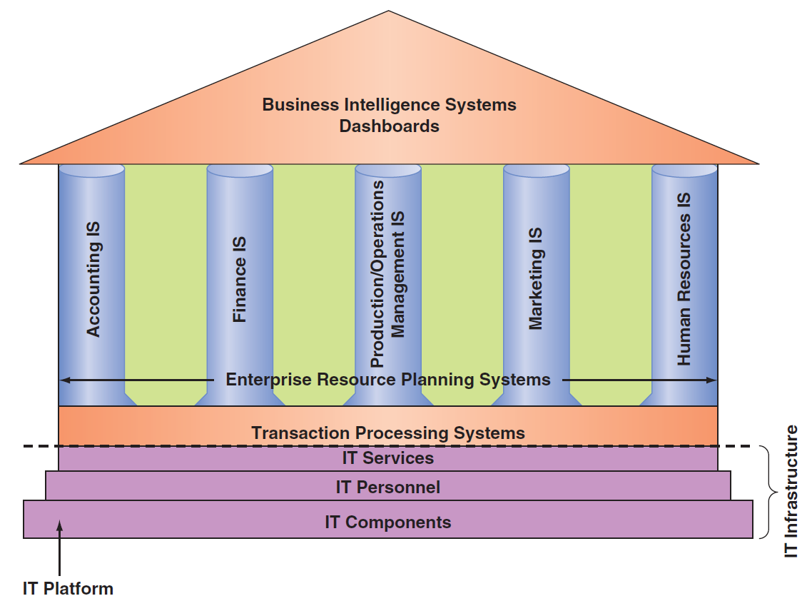
Information technology inside your organization
Notes:
IT Components: Hardware, Software, a database, a network, procedures, and people.
IT Services: IT Personnel use IT Components to develop IS’s, oversee security & risk, and manage data.
IT Infrastructure: The IT components and IT services.
Application: A program designed to support a specific task or business process.
Functional Area Information Systems (FAIS) : a collection of application programs in a single department or functional area.

Slide 28
IT Infrastructure
IT components of hardware, software, networks (wireline and wireless), and databases form the information technology platform.
IT personnel use these components to develop information systems, oversee security and risk, and manage data.
These activities cumulatively are called information technology services.
The IT components plus IT services comprise the organization’s information technology infrastructure.
At the top of the pyramid are the various organizational information systems.

Slide 29
Major Capabilities of IS
Perform high-speed, high-volume numerical computations.
Provide fast, accurate communication and collaboration within and among organizations.
Store huge amounts of information in an easy-to-access, yet small space.
Allow quick and inexpensive access to vast amounts of information, worldwide.
Interpret vast amounts of data quickly and efficiently.
Automate both semiautomatic business processes and manual tasks.

Slide 30
Types of Computer Based Information Systems (CBIS)
Breadth of Support for Information Systems (IS)
Support for Organizational Employees

Slide 31
Breadth of Support for Information Systems (IS)
Functional Area Information Systems (FAIS)
Enterprise Resource Planning Systems (ERP)
Transaction Processing Systems (TPS)
Interorganizational Information Systems (IOS)
E-Commerce Systems
Notes:
Functional Area Information Systems (FAIS) : a collection of application programs in a single department or functional area.
Enterprise Resource Planning (ERP): systems are designed to correct a lack of communication among the functional area IS.
Transaction Processing System (TPS): systems that support the monitoring, collection, storage, and processing of data from the organization’s basic business transactions, each of which generates data.
Interorganizational Information systems (IOSs): Information systems that connect two or more organizations.
Electronic Commerce (e-commerce) Systems: an interorganizational information system that enable organizations to conduct transactions, called business-to-business (B2B) electronic commerce, and customers to conduct transactions with businesses, called business-to-consumer (B2C) electronic commerce.

Slide 32
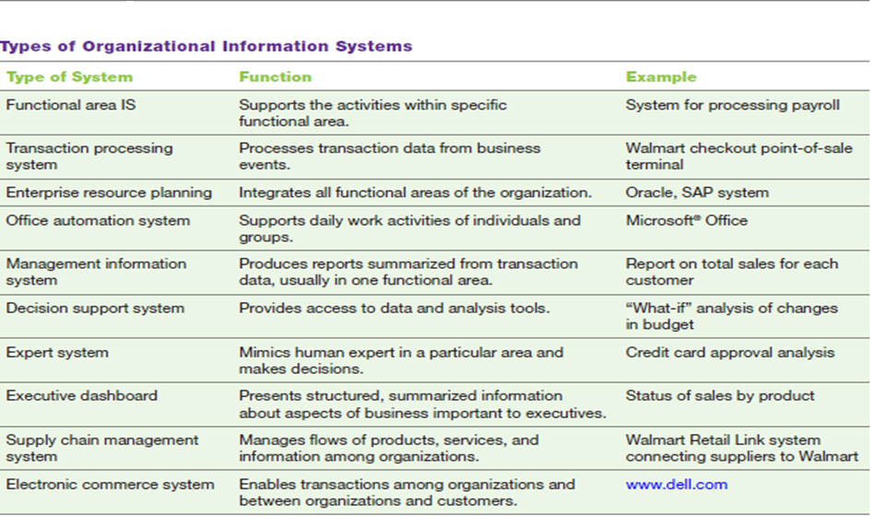
Types of Computer-Based Information Systems

Slide 33
Functional area information systems (FAISs)
supporting pillars for the information systems located at the top, namely, business intelligence systems and dashboards
each FAIS supports a particular functional area within the organization. Examples are accounting IS, finance IS, production/operations management (POM) IS, marketing IS, and human resources IS.
Functional area information systems summarize data and prepare reports, primarily for middle managers, but sometimes for lower-level managers as well.
Because these reports typically concern a specific functional area, report generators (RPGs) are an important type of functional area IS

Slide 34
In finance and accounting, managers use IT systems to forecast revenues and business activity, to determine the best sources and uses of funds, and to perform audits to ensure that the organization is fundamentally sound and that all financial reports and documents are accurate.
In sales and marketing, managers use information technology to perform the following functions:
Product analysis: developing new goods and services
Site analysis: determining the best location for production and distribution facilities
Promotion analysis: identifying the best advertising channels
Price analysis: setting product prices to obtain the highest total revenues
Marketing managers also use IT to manage their relationships with their customers.
In manufacturing, managers use IT to process customer orders, develop production schedules, control inventory levels, and monitor product quality. They also use IT to design and manufacture products. These processes are called computer-assisted design (CAD) and computer-assisted manufacturing (CAM).
Managers in human resources use IT to manage the recruiting process, analyze and screen job applicants, and hire new employees. They also employ IT to help employees manage their careers, to administer performance tests to employees, and to monitor employee productivity. Finally, they rely on IT to manage compensation and benefits packages.

Slide 35
Types of Computer Based Information Systems (CBIS)
Enterprise resource planning (ERP) systems are
designed to correct a lack of communication among the functional area Iss.
ERP systems were an important innovation because the various functional area ISs were often developed as standalone systems and did not communicate effectively (if at all) with one another.
ERP systems resolve this problem by tightly integrating the functional area ISs via a common database.
In doing so, they enhance communications among the functional areas of an organization.

Slide 36
Types of Computer Based Information Systems (CBIS)
A transaction processing system (TPS) supports the monitoring, collection, storage, and processing of data from the organization’s basic business transactions, each of which generates data.
When you are checking out at Walmart, for example, a transaction occurs each time the cashier swipes an item across the bar code reader.
Significantly, within an organization, different functions or departments can define a transaction differently. In accounting, for example, a transaction is anything that changes a firm’s chart of accounts.
The information system definition of a transaction is broader: A transaction is anything that changes the firm’s database

Slide 37
Types of Computer Based Information Systems (CBIS)
Electronic commerce (e-commerce) systems are another type of inter organizational information system.
These systems enable organizations to conduct transactions, called business-to business (B2B) electronic commerce, and customers to conduct transactions with business, called business-to-consumer (B2C) electronic commerce. E-commerce systems typically are Internet-based.

Slide 38
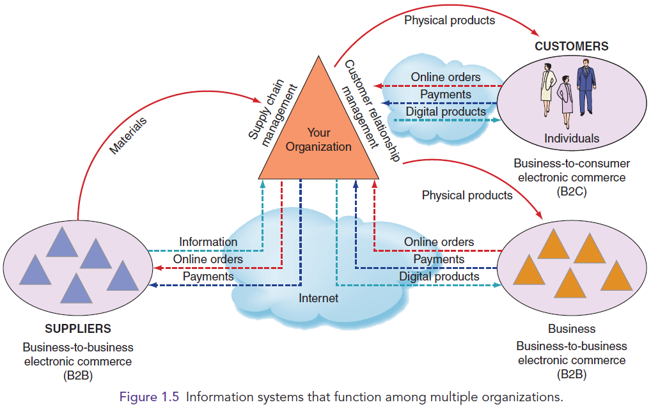
IS that function among multiple organizations

Slide 39
Support for
Organizational Employees
Knowledge Workers
Office Automation Systems (OASs)
Business Intelligence (BI) Systems
Expert Systems (ES)
Dashboards
Notes:
Knowledge Workers: professional employees that are experts in a particular subject area (e.g., financial and marketing analysts, engineers, lawyers, and accountants.).
Office Automation Systems (OASs): typically support the clerical staff, lower and middle managers, and knowledge workers (e.g., word processing and desktop publishing software).
Business Intelligence (BI) Systems: systems that provide computer-based support for complex, nonroutine decisions, primarily for middle managers and knowledge workers.
Expert Systems (ES): systems that attempt to duplicate the work of human experts by applying reasoning capabilities, knowledge, and expertise within a specific domain.
Dashboards: a special form of IS that support all managers of the organization by providing rapid access to timely information and direct access to structured information in the form of reports.

Slide 40
Types of Computer Based Information Systems (CBIS)
Knowledge workers are professional employees such as financial and marketing analysts, engineers, lawyers, and accountants.
All knowledge workers are experts in a particular subject area. They create information and knowledge, which they integrate into the business.
Knowledge workers, in turn, act as advisors to middle managers and executives.
Finally, executives make decisions that deal with situations that can significantly change the manner in which business is done. Examples of executive decisions are introducing a new product line, acquiring other businesses, and relocating operations to a foreign country

Slide 41
Types of Computer Based Information Systems (CBIS)
Office automation systems (OASs) typically support the clerical staff, lower and middle managers, and knowledge workers.
These employees use OASs to develop documents (word processing and desktop publishing software), schedule resources (electronic calendars), and communicate (e-mail, voice mail, videoconferencing, and groupware).

Slide 42
Types of Computer Based Information Systems (CBIS)
Business intelligence (BI) systems provide computer-based support for complex, non routine decisions, primarily for middle managers and knowledge workers. (They also support lower-level managers, but to a lesser extent.)
These systems are typically used with a data warehouse, and they enable users to perform their own data analysis

Slide 43
Expert systems (ESs) attempt to duplicate the work of human experts by applying reasoning capabilities, knowledge, and expertise within a specific domain.
They have become valuable in many application areas, primarily but not exclusively areas involving decision making.
For example, navigation systems use rules to select routes, but we do not typically think of these systems as expert systems.
Significantly, expert systems can operate as standalone systems or be embedded in other applications

Slide 44
Dashboards (also called digital dashboards) are a special form of IS that support all managers of the organization.
They provide rapid access to timely information and direct access to structured information in the form of reports.
Dashboards that are tailored to the information needs of executives are called executive dashboards.

Slide 45
How Does
IT Impact Organizations?
IT Reduces the Number of Middle Managers
IT Change’s the Manager’s Job
Will IT Eliminate Jobs?
IT Impacts Employees at Work

Slide 46
How Does IT Impact Organizations?
IT Reduces the Number of Middle Managers
IT makes managers more productive, and it increases the number of employees who can report to a single manager.
Thus, IT ultimately decreases the number of managers and experts.
It is reasonable to assume, therefore, that in coming years organizations will have fewer managerial levels and fewer staff and line managers.
If this trend materializes, promotional opportunities will decrease, making promotions much more competitive

Slide 47
IT Changes the Manager’s Job
A major consequence of IT has been to change the manner in which managers make their decisions.
In this way, IT ultimately has changed managers’ jobs.
IT often provides managers with near-real-time information, meaning that managers have less time to make decisions, making their jobs even more stressful.
Fortunately, IT also provides many tools—for example, business analytics applications such as dashboards, search engines, and intranets—to help managers handle the volumes of information they must deal with on an ongoing basis.

Slide 48
IT Impacts
Employees at Work
IT Impacts Employees’ Health and Safety
IT Provides Opportunities for People with Disabilities

Slide 49
IT Impacts Employees’ Health and Safety.
Although computers and information systems are generally regarded as agents of “progress,” they can adversely affect individuals’ health and safety. IT: job stress and long-term use of the keyboard.
An increase in an employee’s workload and/or responsibilities can trigger job stress.
Although computerization has benefited organizations by increasing productivity, it also has created an ever-expanding workload for some employees.
Some workers feel overwhelmed and have become increasingly anxious about their job performance.
These feelings of stress and anxiety can actually diminish rather than improve workers’ productivity while jeopardizing their physical and mental health. Management can help alleviate these problems by providing training, redistributing the workload among workers, and hiring more workers.
On a more specific level, the long-term use of keyboards can lead to repetitive strain injuries such as backaches and muscle tension in the wrists and fingers.
Carpal tunnel syndrome is a particularly painful form of repetitive strain injury that affects the wrists and hands.

Slide 50
IT Provides Opportunities for People with Disabilities.
Computers can create new employment opportunities for people with disabilities by integrating speech-recognition and vision-recognition capabilities.
For example, individuals who cannot type can use a voice-operated keyboard, and individuals who cannot travel can work at home.
Going further, adaptive equipment for computers enables people with disabilities to perform tasks they normally would not be able to do.
For example, the Web and graphical user interfaces (GUIs; e.g., Windows) can be difficult for people with impaired vision to use. To address this problem, manufacturers have added audible screen tips and voice interfaces, which essentially restore the functionality of computers to the way it was before GUIs become standard.

Slide 51
1.4
Importance of IS to Society
IT Affects Our Quality of Life
The Robot Revolution is Here Now
Improvements in Healthcare

Slide 52
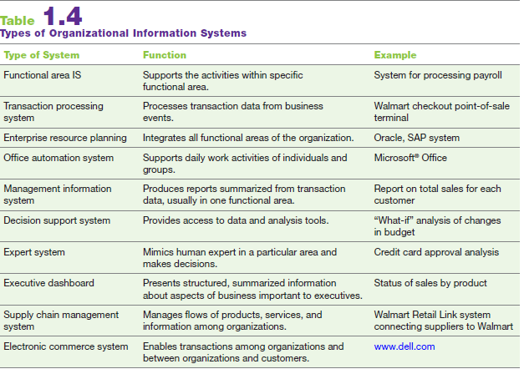
Types of Computer-Based Information Systems

